Slide 2
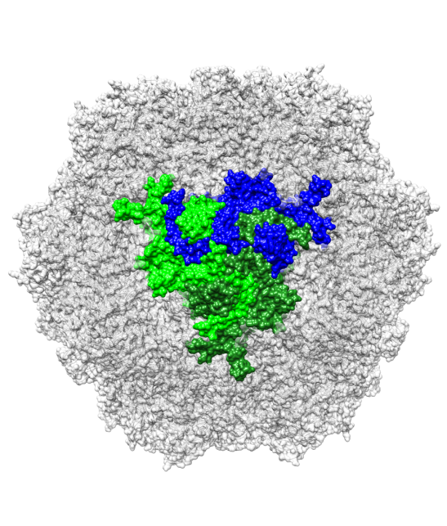
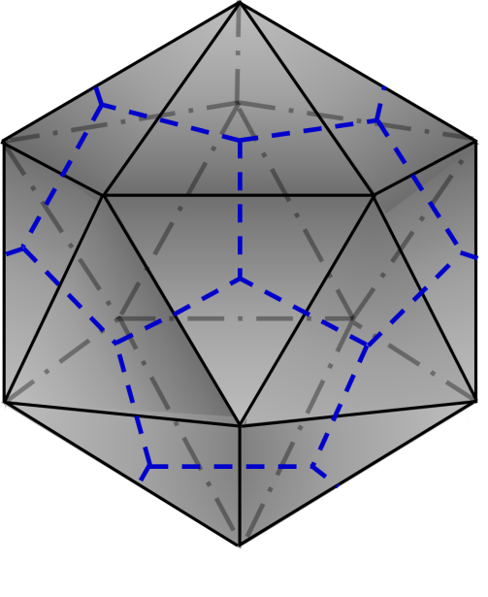
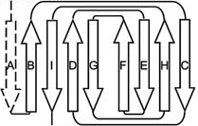
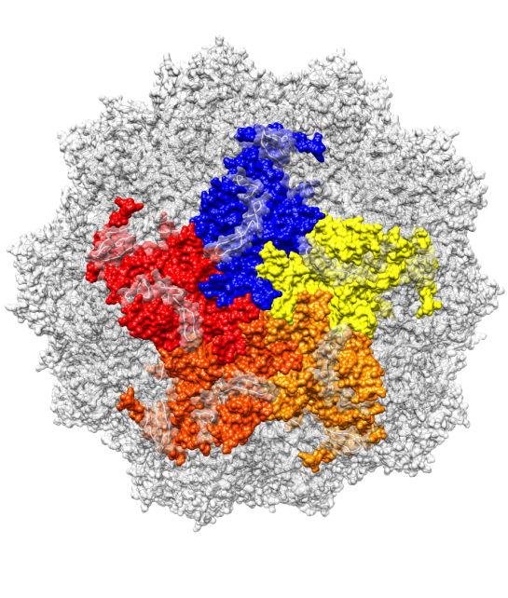
Trimer
N-terminus
2f
5f
3f
Pentamer
C-terminus

Slide 3
A
B
C

Slide 4
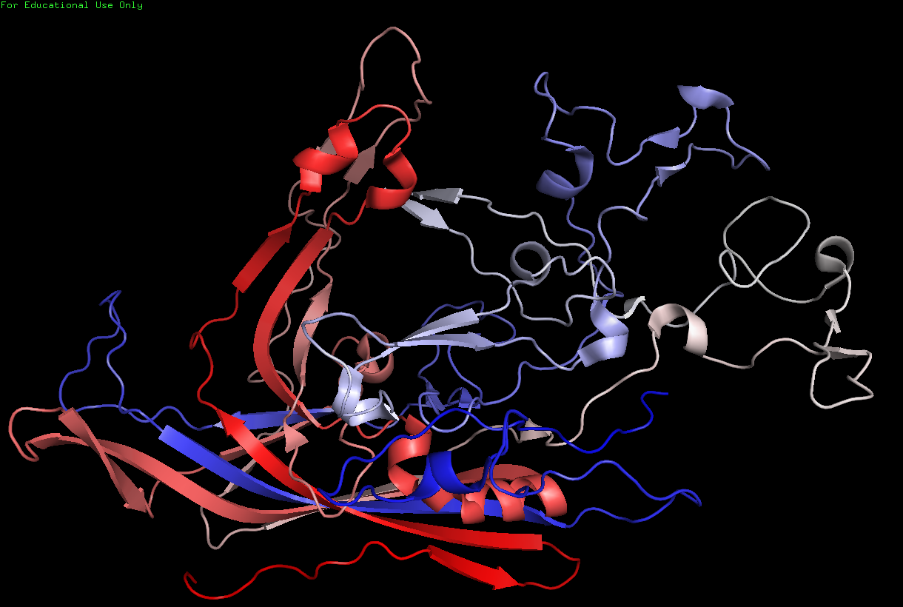
A
Loop 1
Loop 4
EXTERIOR
Loop 2
HI Loop
Loop 3
βC
(587) - COOH
βH
βE
DE Loop
βI
βF
αA
βD
βG
βB
2
5
INTERIOR
H₂N - (39)
βA
3
B
Trimer
C
N-terminus
2f
5f
3f
Pentamer
C-terminus

